Slide 1
Module IV- Cloud Providers & Software Platforms
Dr. Madhukrishna Priyadarsini
Assistant Professor
NIT Trichy

Slide 2
Outline:
Globally available public clouds
AWS
Azure
GCP
Introduction to open source software
Eucalyptus
Open Nebula
OpenStack
Apache Cloudstack

Slide 3
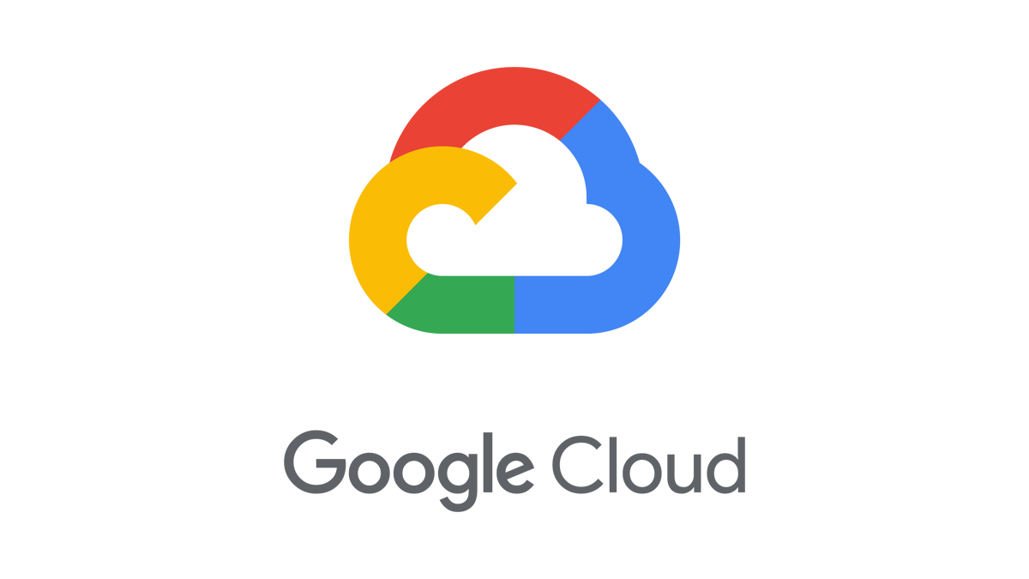
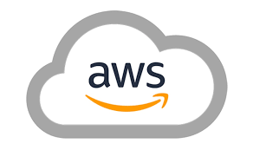
Cloud platforms overview and comparison:
Amazon Web Services (AWS) is a cloud management platform that manages and maintains hardware and infrastructure, reducing the expense and complexity
Microsoft Azure is a cloud computing service that offers a collection of cloud computing services for building, testing, deploying, and managing applications in cloud
Google Cloud Platform (GCP) offers a variety of cloud computing services for building, deploying, scaling, monitoring, and operating a cloud

Slide 4
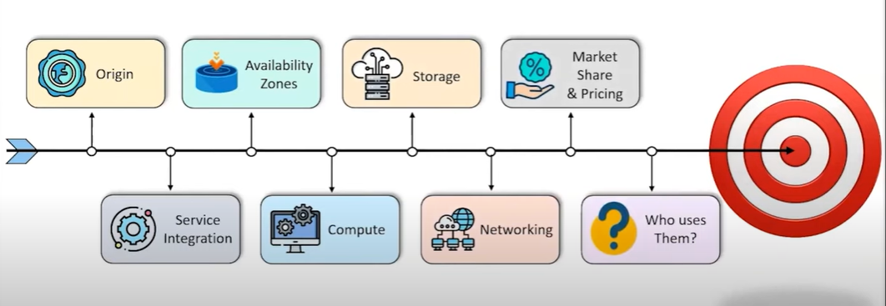
Comparison parameters

Slide 5
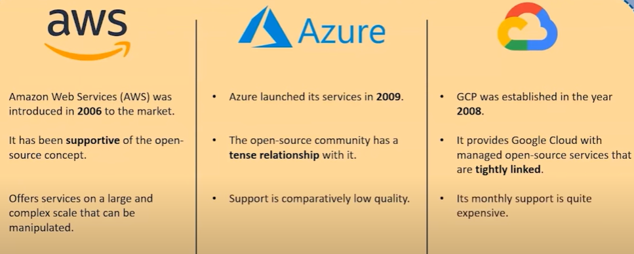
Origin:

Slide 6
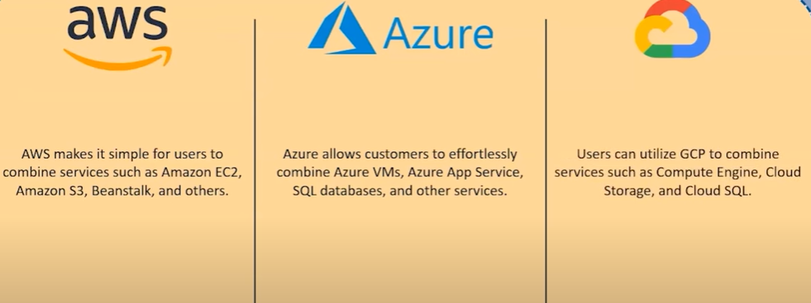
Service Integration:

Slide 7
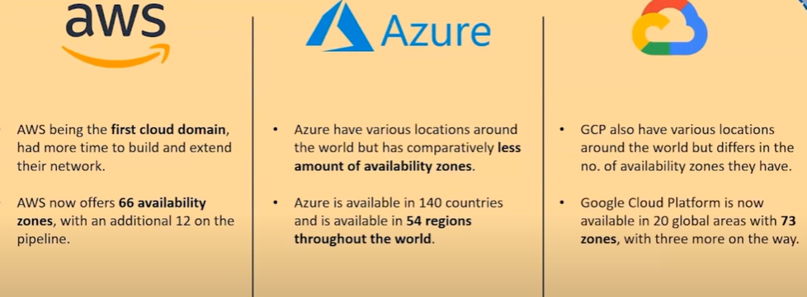
Availability Zone:

Slide 8
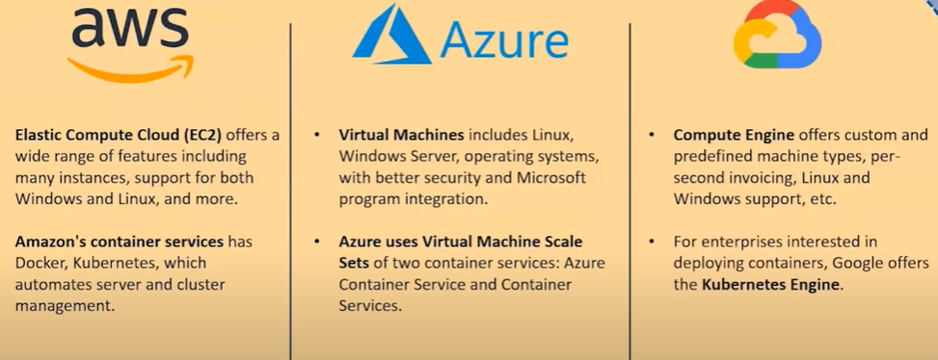
Compute/Instance:

Slide 9
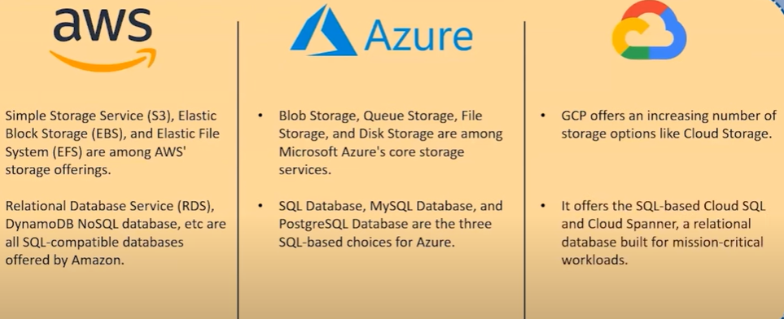
Storage:

Slide 10
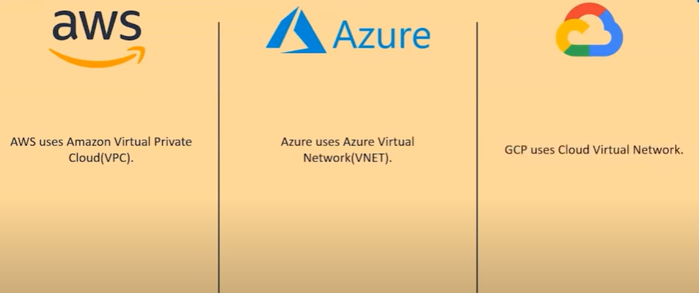
Networking:

Slide 11
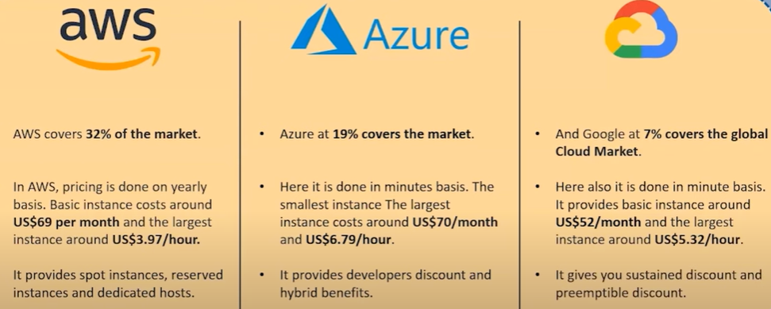
Market Share & Pricing:

Slide 12
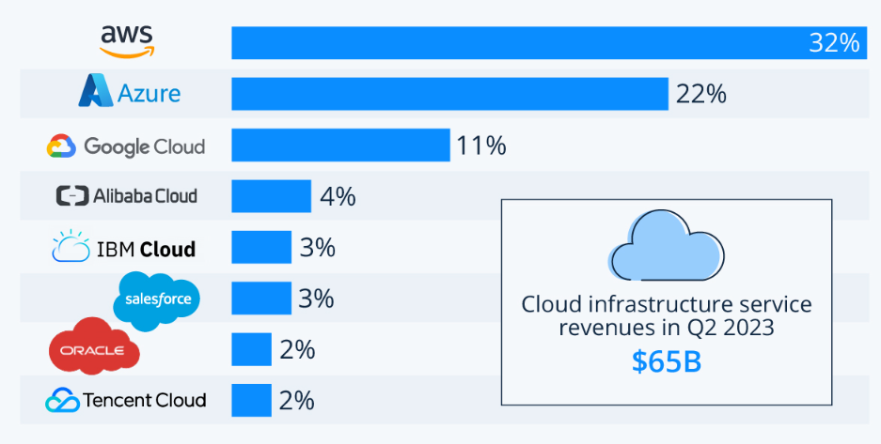
Market shares of leading cloud service providers in Q2 2023*

Slide 13
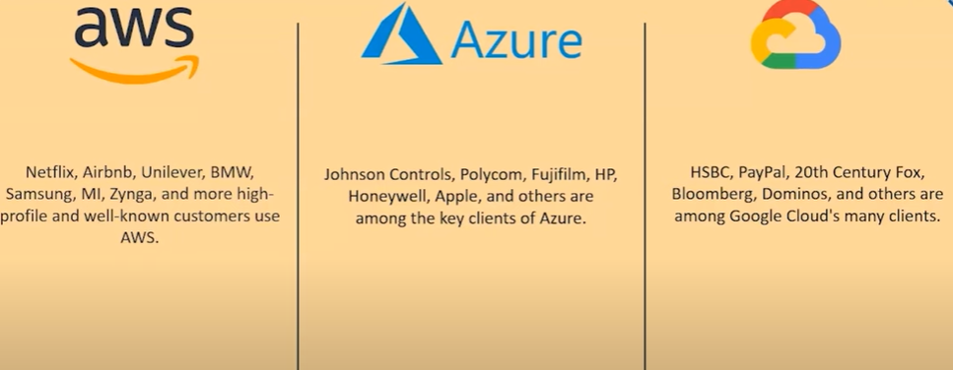
Who Uses Them?

Slide 14
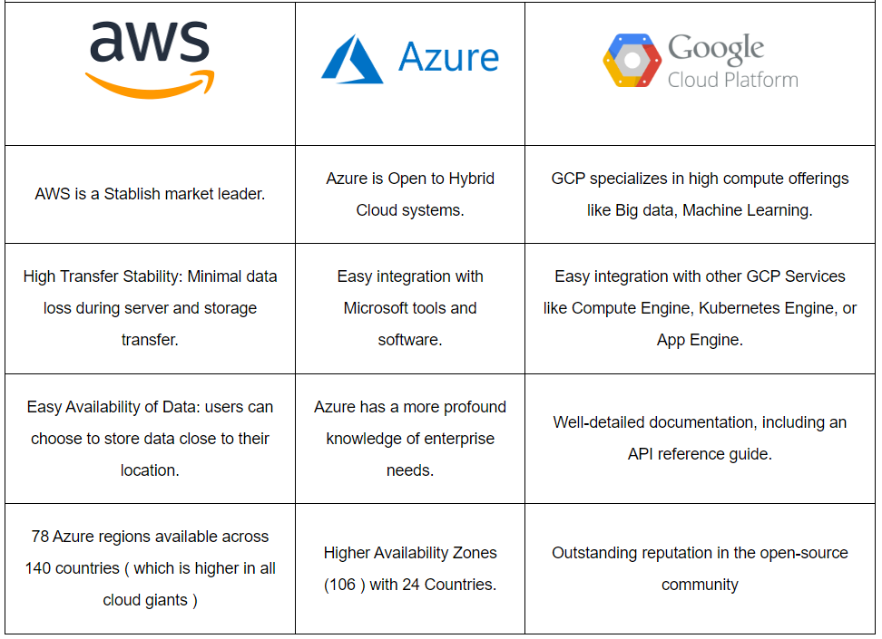
AWS Vs. Azure Vs. GCP Pros

Slide 15
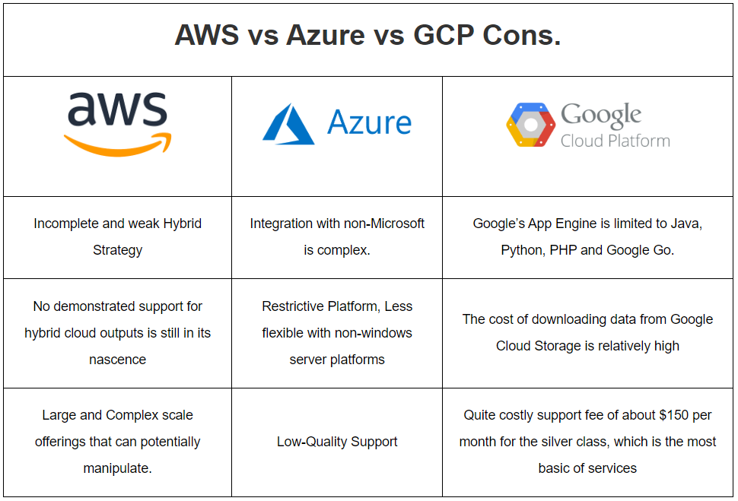
AWS Vs. Azure Vs. GCP Cons

Slide 16
Open Source Software:
Open Source Cloud Software is used to build private, public, and hybrid clouds which are compatible with the already available cloud platforms in market.
In other words, the open source cloud software is interoperable with any back-end platform and can easily be migrated to a different IT infrastructure/environment.
Majorly used open source cloud software are:
Eucalyptus
Open Nebula
Open Stack
Apache Cloudstack

Slide 17
Open Source Cloud Infrastructure
Simple
Transparent-> need to see in to the ‘cloud’
Scalable-> complexity often limits scalability
Extensible
New application classes and service classes may require new features
Clouds are new-> needs to extend while retaining useful features
Commodity-based
Must leverage extensive catalog of open source software offerings
Easy
To install-> system administration time is expensive
To maintain-> system administration time is really expensive

Slide 18
Open Source Cloud Anatomy
Extensibility
Simple architecture and open internal APIs
Client-side interface
Amazon’s AWS interface and functionality (familiar and testable)
Compute
Multiple hypervisors and image formats
Networking
Virtual private network (VPN) per cloud allocation
Storage
Cloud storage models using generic OS functionality
Security
Must be compatible with local security policies
Packaging, installation, maintenance
Minimal intrusiveness, maximal portability

Slide 19
1- Eucalyptus (Elastic Utility Computing Architecture Linking Your Programs To Useful Systems)
Eucalyptus is open source software for building AWS-compatible private and hybrid clouds.
As an Infrastructure as a Service product, Eucalyptus allows you to flexibly provision your own collections of resources (both compute and storage), on an as-needed basis.
It is a web services based implementation of elastic/utility/cloud computing infrastructure
Linux image hosting ala Amazon

Slide 20
Goals of Eucalyptus:
Foster greater understanding and uptake of cloud computing
Provide a vehicle for extending what is known about the utility model of computing
Experimentation vehicle prior to buying commercial services
Provide development, debugging, and “tech preview” platform for public clouds
Homogenize local IT environment with public clouds
AWS functionality locally makes moving using Amazon AWS easier, cheaper, and more sustainable
Provide a basic software development platform for the open source community
E.g., the “Linux experience”
Not designed as a replacement technology for AWS or any other public cloud service

Slide 21
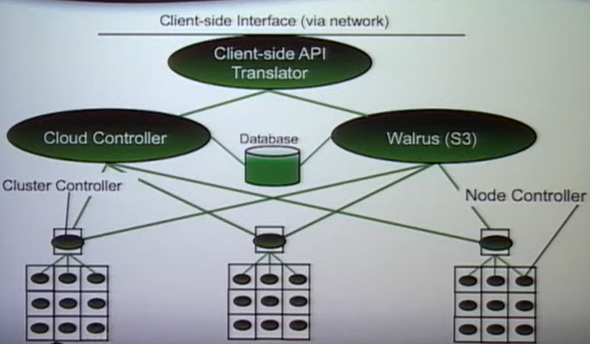
Architecture:

Slide 22
Client side Interface
Interface is based on Amazon’s published WSDL
EC2, S3, EBS
Availability zones correspond to individual clusters
Uses either Amazon tool or Eucalyptus replacements
Web services and REST interfaces
Looking at Sun’s new API
Initial set of 14 calls looks interesting
Need well-defined error codes
System administration is different
Eucalyptus defines its own cloud admin tool set for user accounting and cloud management

Slide 23
Networking
Eucalyptus does not assume that all worker nodes will have publicly routable IP addresses.
All cloud images have access to a private network interface
Three networking modes:
System Mode-> hosted VMs use local DHCP to get IP addresses (Eucalyptus does not control the routing)
Static Mode-> cloud administrator configures a set of usable public IP addresses (Eucalyptus hands them out via DHCP)
Managed Mode-> all VMs get a private address and Eucalyptus uses IP tables for local and remote routing (Elastic Ips and security groups only work in managed mode)
Availability zone approach fits with Amazon’s high level semantics

Slide 24
Security
All Eucalyptus components use WS-security for authentication
Encryption of inter component communication is not enabled by default (configuration option)
SSH key generation and installation is implemented
User sign-up is web-based
User specifies a password and submits sign-up request
Certificate is generated but withheld until admin approves the request
User gains access to the certificate through password-protected web page

Slide 25
Packaging and installation
From source
Tarball download
Ubuntu universe (sudo apt-get install Eucalyptus)
Distributing updates via apt-get as well
From binary
Ubuntu
Debian “lenny” and “squeeze”
CentOS RPM (catches most of the RedHat derivatives)
OpenSUSE (poll based)

Slide 26
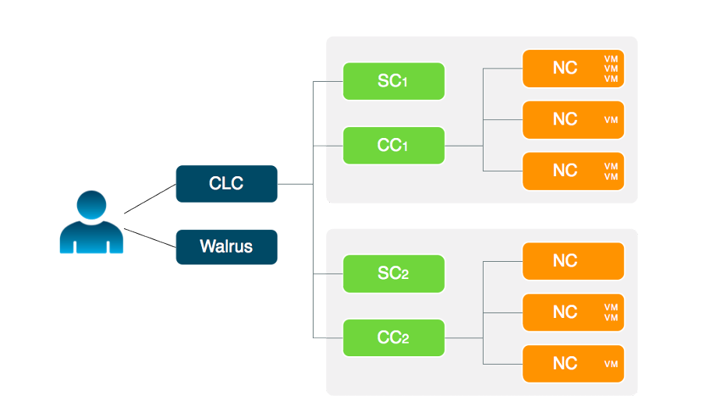
Eucalyptus Components
Cloud Controller (CLC)
Walrus
Cluster Controller (CC)
Storage Controller (SC)
VM Broker
Node Controller(NC)

Slide 27
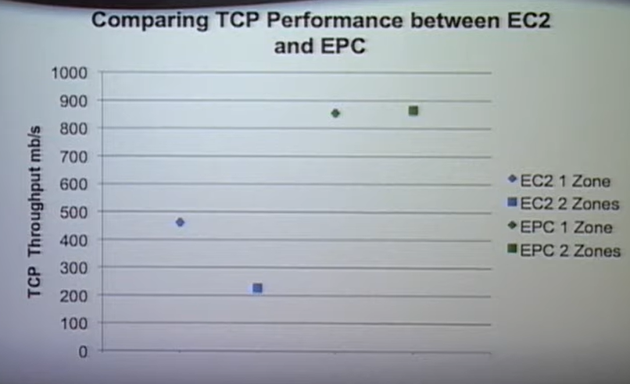
Bandwidth Performance

Slide 28
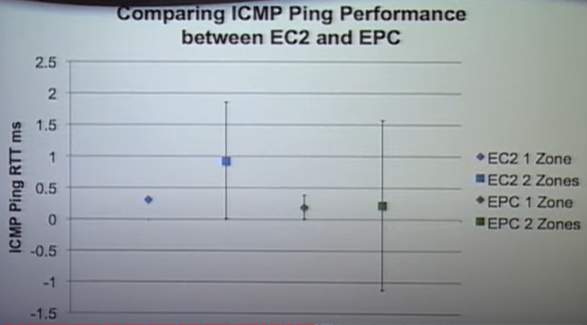
RTT Performance

Slide 29
Eucalyptus Ecosystem
AppScale
Google App engine atop Eucalyptus
Multiple scalable database backends
RightScale
Local enterprises focused on providing client tools as SaaS hosed in AWS
Current release includes registration protocol for RightScale
CohesiveFT
Elastic server, personal edition targets Eucalyptus as the on-premise platform
rPath
“Appliancizing” Eucalyptus

Slide 30
Installation, Configuration, and Working Environment of Eucalyptus
Configure the dependencies
Disable Firewall
Configure Network Time Protocol (NTP)
Configure Java
Configure Mail Transport Agent (MTP) server
Install Repository
Install Eucalyptus Release Package
Configure Eucalyptus
Configure Network modes
Create Network JSON file
Create scheduling policy
Start Eucalyptus

Slide 31
2- Open Nebula (Sponsored by Open Nebula Systems)
It is an open source cloud computing platform for managing heterogeneous data center, public cloud, and edge computing infrastructure resources. Basically it is developed for managing the enterprise.
Open Nebula manages on-premise and remote virtual infrastructure to build private, public, or hybrid implementations of IaaS platform.
Two main implementations of Open Nebula are; data center virtualization and cloud deployments.
The major features of Open Nebula are:
Self-service
Provisioning
Multi-tenancy
Elasticity

Slide 32
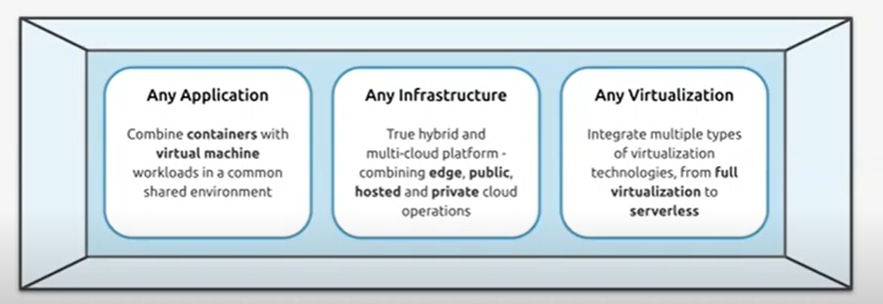
What is Open Nebula?
A “Single Pane of Glass” to bring real freedom to your enterprise cloud.
Avoids “Vendor Lock-in”
Minimizes complexity
Reduces resource consumption
Slashes operating cost

Slide 33
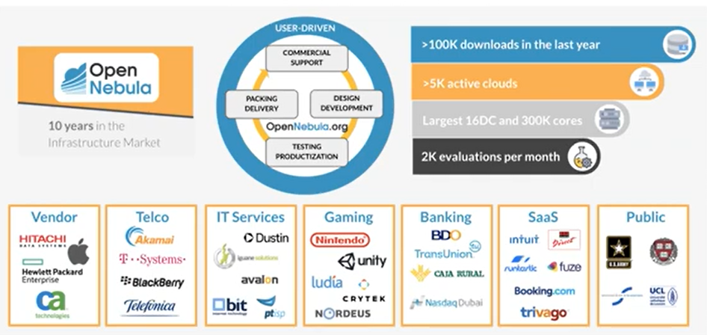
Who is using Open Nebula?
A widely adopted solution to build clouds

Slide 34
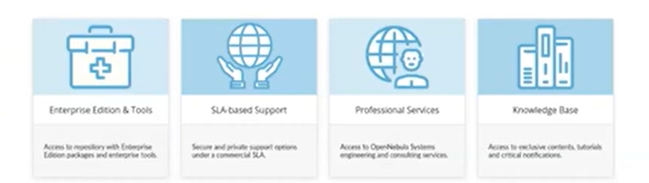
Open Nebula Subscription
Enterprise Edition provides customers a hardened LTS version with software patches, bug fixes, and minor enhancements
Enterprise tool-> OneScape
Support provided through a private and secure support portal-> 9*5 or 24*7
Professional Services
Cloud deployment
Upgrade
Training
Consulting/Engineering
Knowledge Base with best practices, step-by-step guides, and use cases

Slide 35
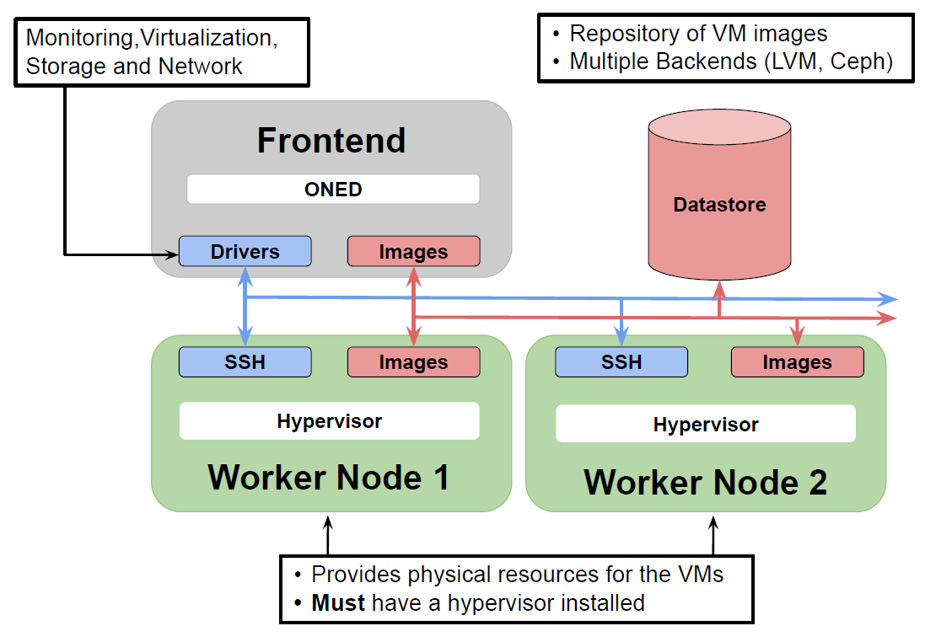
Open Nebula’s Open Architecture
Software platform to build enterprise clouds for DevOps and Development workloads

Slide 36
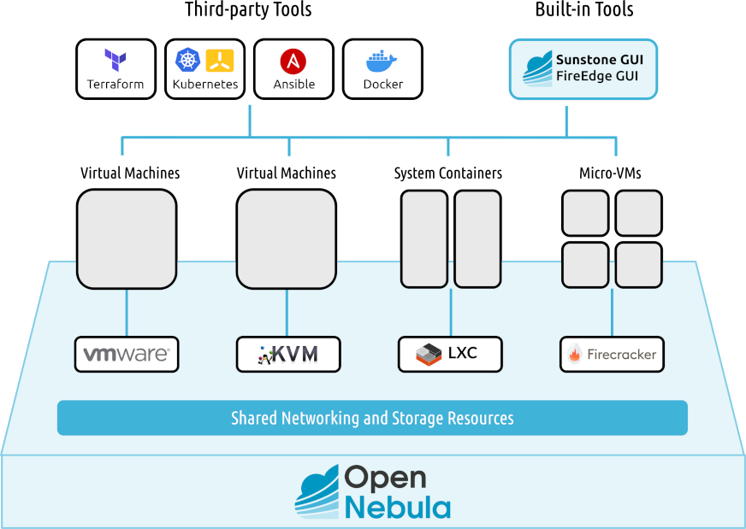

Slide 37
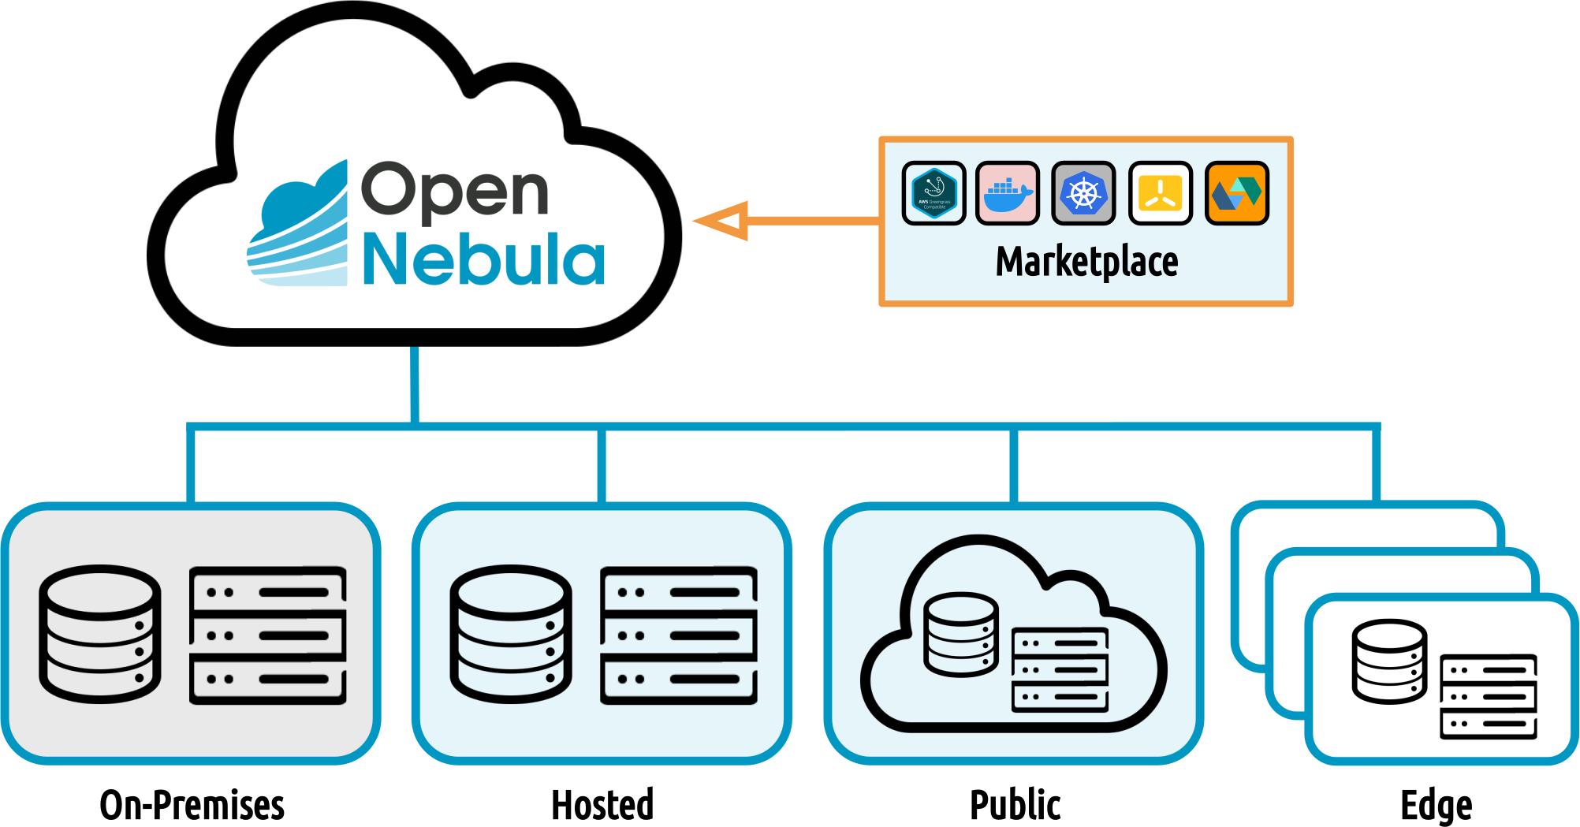
How is Open Nebula being used?

Slide 38
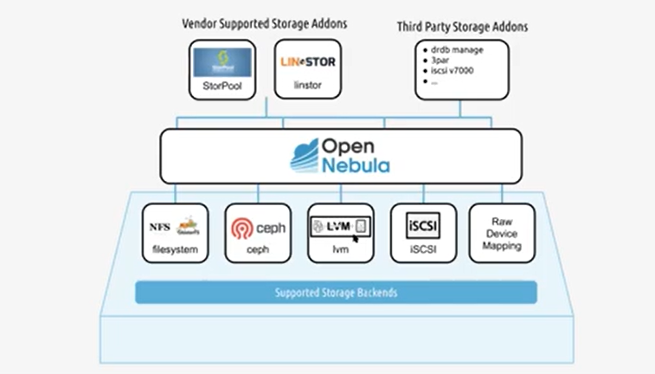
Storage Backends

Slide 39
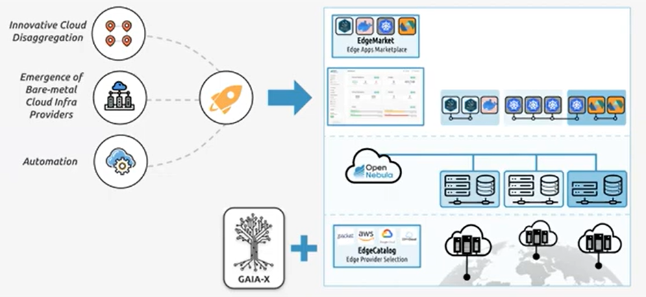
ONEedge.io (Expanding open source cloud computing to the edge)

Slide 40
Installation, Configuration, and Working Environment of Open Nebula
Install the repo: /etc/yum.repos.d/opennebula.repo
Install packages: yum install opennebula …
Install gems: /usr/share/one/install_gems
Enable OpenNebula services
Configure Storage
Configure Network
Configure passwordless ssh access
OpenNebula configuration files

Slide 41

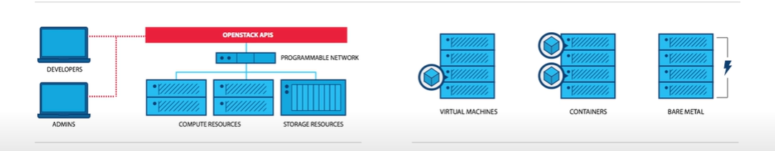
3- OpenStack (By Rackspace Technology)
OpenStack is an open source software that provides cloud infrastructure for virtual machines, bare metals, and containers.
Programmable infrastructure that lays a common set of APIs on top of compute, networking, and storage.
One platform for virtual machines, containers, and bare metals.

Slide 42


Who uses OpenStack?
Open Stack Features:
Scalable
Reliable
Flexible
Provides control

Slide 43
OpenStack Deployment Models
Open Stack on-premises
Open Stack Appliances
Open Stack Hosted Cloud
Open Stack-as-a-service

Slide 44
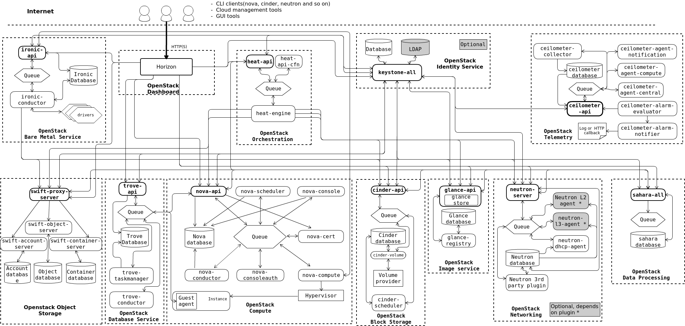
OpenStack Architecture

Slide 45
OpenStack Architecture
OpenStack Components
Horizon (Dashboard)
Ceilometer (Telemetry)
Nova (Compute)
Swift (Object Store)
Cinder (Block Storage)
Neutron (Networking)
Heat (Orchestration)
Glance (Image)
Keystone (Identity)

Slide 46
Horizon is a canonical implementation of OpenStack’s dashboard, which provides a web-based user interface to OpenStack services.
Nova is the OpenStack project that provides a way to provision compute instances. Nova supports creating virtual machines, bare metal servers, and has limited support for system containers. Nova runs as a set of daemons on top of existing Linux servers to provide that service.
Swift is a highly available, distributed, eventually consistent object/blob store. Organizations can use Swift to store lots of data efficiently, safely, and cheaply.
Horizon (Dashboard)
Nova (Compute)
Swift (Object Store)

Slide 47
Cinder is the OpenStack block storage service for providing volumes to Nova virtual machines, Ironic bare metal hosts, containers and more.
Neutron is an OpenStack object to provide “network connectivity as a service” between interface devices managed by other OpenStack services (e.g., Nova). It implements the OpenStack networking API.
Heat is a service to orchestrate composite cloud applications using a declarative template format through an OpenStack-native REST API. A Heat template describes the infrastructure for a cloud application in text files which are readable and writable by humans, and can be managed by version control tools.
Cinder (Block Storage)
Neutron (Networking)
Heat (Orchestration)

Slide 48
The image service (Glance) project provides a service where users can upload and discovers data assets that are meant to be used with other services. This currently includes images and meta-data definitions. Glance image services include discovery, registering, and retrieving virtual machine (VM) images. Glance has a restful API that allows querying of VM image metadata as well as retrieval of the actual image.
OpenStack ceilometer (Telemetry) offers a single point of contact for many billing systems, facilitating each counter they require to build customer billing around every future and current component of OpenStack.
Keystone is the OpenStack service that provides API client authentication, service discovery, and distributed multi-tenant authorization by implementing OpenStack’s identity API.
Glance (Image)
Ceilometer (Telemetry)
Keystone (Identity)

Slide 49
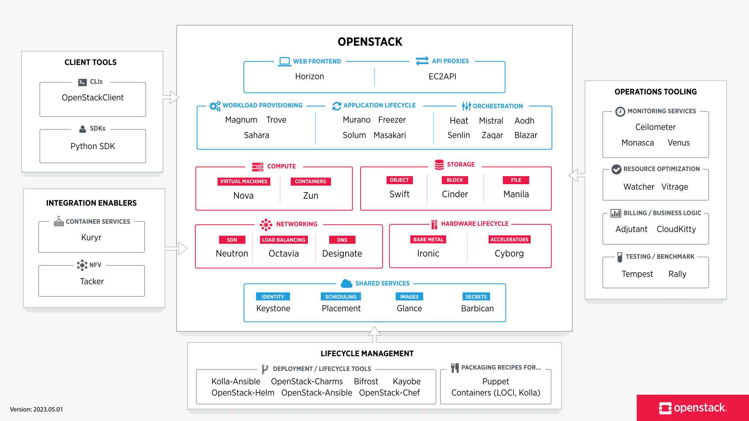
The OpenStack Landscape

Slide 50
How to install and Configure OpenStack?
Create the environment for OpenStack
Install OpenStack packages
Finalize the installation
Install OpenStack services
Launch an OpenStack instance
Create the VM, storage, database etc.

Slide 51
4- Apache CloudStack
Apache CloudStack is a scalable, multi-tenant, open source, purpose-built, cloud orchestration platform for delivering turnkey IaaS as a cloud.
Key features:
Integrated end-to-end IaaS product
Proven at scale, wide-spread adoption
Rapid time to value
Low implementation and operation cost
Truly multi-tenant
Free and Open Source
Easy integration

Slide 52
Available Functionalities:
User self-service
Web UI, Command line, REST-based API
Broad and deep hypervisor support
Xen-server, KVM, VMWare, Oracle VM, Hyper-V, XCP-ng
Support for Kubernetes cluster
Enterprise grade tenant virtual networking model
Scalable architecture
Supports thousands of hosts and virtual machine guests
Largest known production cloud 35k+ physical hosts
High availability
Configuration that provide automatic failover for virtual machines

Slide 53
Architecture
Ecommerce Platform
Orchestration API
CMP- Orchestration Layer
Hypervisor
Networking
Compute
Storage

Slide 54
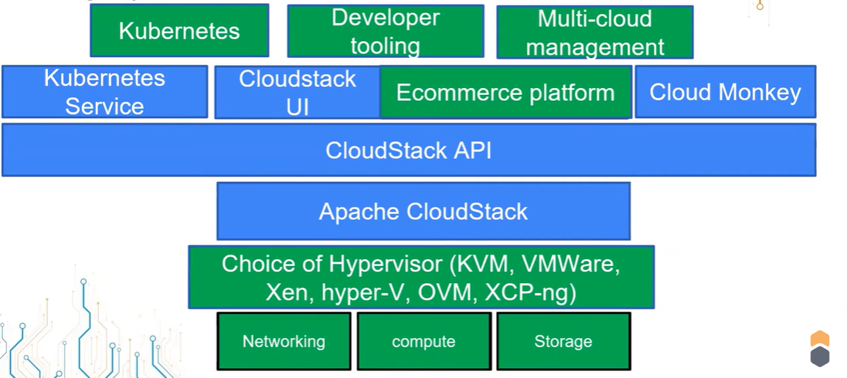

Slide 55
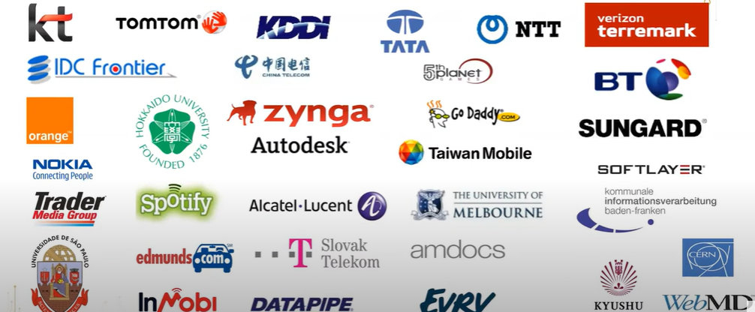
Organizations using Apache CloudStack

Slide 56
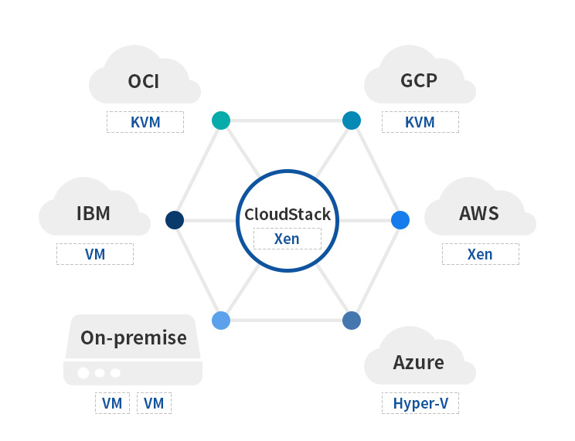

CloudStack Use-cases

Slide 57
What can we do with CloudStack?
Self service of all resources- compute, storage, and networking- with no requirements of highly skilled technical staff.
Automation of all provisioning and management through API/UI/CLI.
Examples;
Create virtual machines from templates or ISOs
All virtual machine life cycle actions: start/stop/delete/storage/networking
Manage storage volumes
Create isolated, shared, and multi-tiered networks
Manage firewall and port forwarding rules
Manage network services such as load balancing, static and source NAT, VPNs, global load balancing, and auto-scaling
Create container clusters

Slide 58
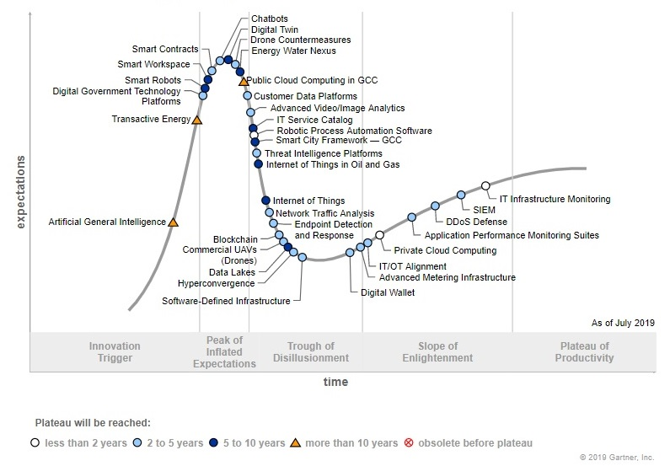
Hype Cycle of Cloud Computing

Slide 59
CloudStack Networking Models
Basic zone- Shared network model (all VMs share a single L2 network, simple to set up, security groups are attached, scales very well, VMs route traffic directly to the gateway)
Advanced zone network model (sophisticated network topologies, VMs share VPC, provides the most flexibility and network functions when defining guest networks, different tenant’s networks use SDN technologies, virtual router per isolated network, complex to understand the set up)
Advanced zone- Shared network model (similar to basic zone, usually without security groups, provisioned by cloud administrator)
Advanced zone-Isolated network model (single network behind virtual router, most networking features present such as VPN, load balancer, private gateway, provisioned by end users, a number of specialized physical devices can be used for some of the networking functions)

Slide 60
Advanced zone-VPC (richest network model, multiple network behind virtual router, provisioned by end users, special network cases such as private gateway networks (VPC internal network), network services supported such as ACL, port forwarding, VPN, load balancing, DHCP, DNS, routing etc.)
Advanced zone- L2 networks (a special case, closed VLAN, CloudStack used for orchestration of everything-except networking, all services are provided on physical layer by datacenter administrator, no IPAM )

Slide 61
Installation and Configuration:
https://docs.cloudstack.apache.org/en/4.18.1.0/
Quick Installation Guide:
https://docs.cloudstack.apache.org/en/4.18.1.0/quickinstallationguide/qig.html

